Slide 1

Healthcare Revenue Cycle Management Data Pipeline
End-to-End Analytics-Ready Data Platform
Md Arbaz Khan
Notes:
1

Slide 2
Problem Statement: Unlocking Healthcare Data
Fragmented Data Sources
Inconsistent Formats
Lack of Unified Insights
Data scattered across various hospital systems, making holistic analysis challenging.
Disparate data types and schemas hinder unified reporting and insights.
Limited ability to track historical changes (SCD) and derive comprehensive business intelligence.
Project Goal: Build a centralized data pipeline to ensure data quality, historical tracking, and actionable insights for RCM.
Notes:
2

Slide 3
Architecture Overview: Data Flow for RCM
Our architecture centralizes RCM data, integrating diverse sources into a robust pipeline. Python and Pandas facilitate ETL, transforming raw data into an analytics-ready format within BigQuery. Key features include comprehensive logging, stringent validation, and inherent scalability to handle growing data volumes.
Notes:
3

Slide 4
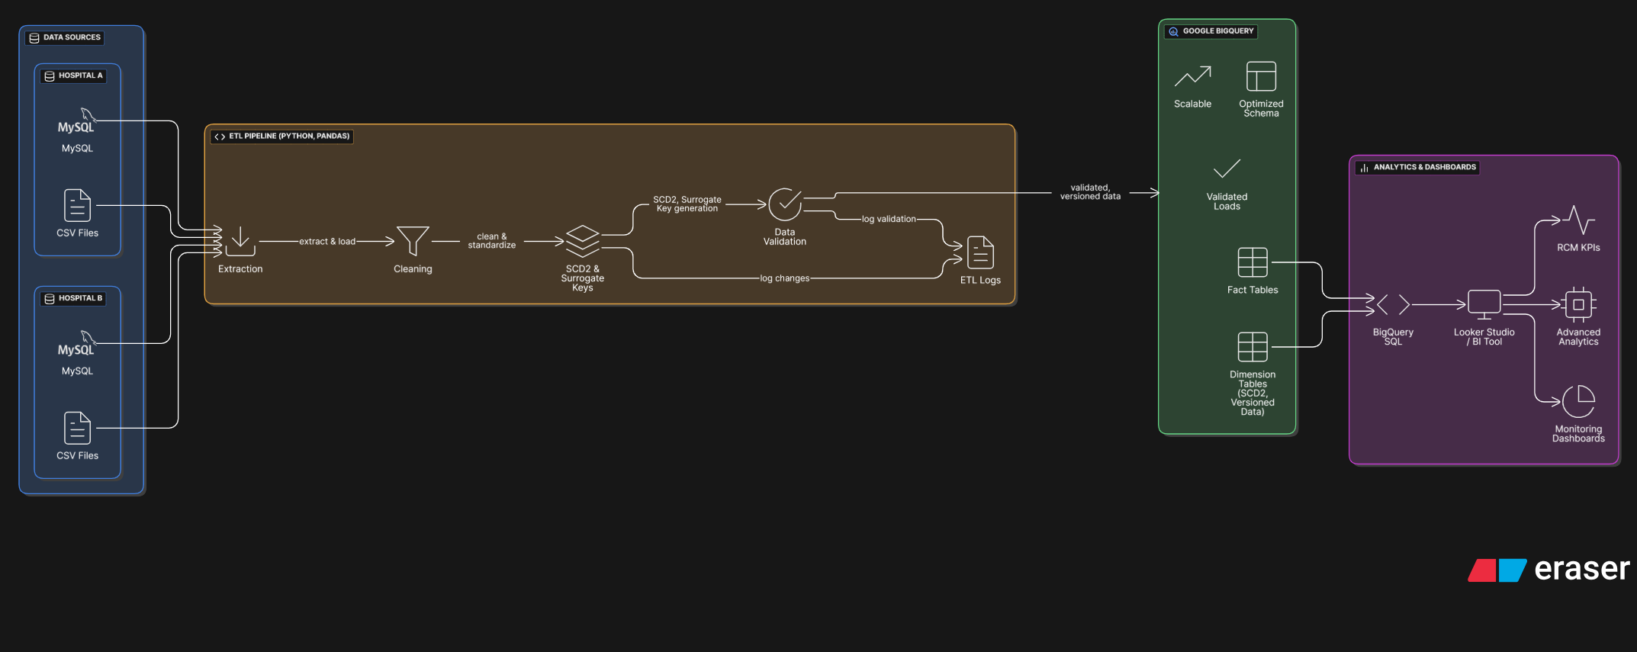

Slide 5
Data Sources & Schema Design
Key Data Sources
Dimensional Modeling
Patient demographics files
dim_patients (SCD Type 2 for historical changes)
Provider master databases
dim_providers
Claims transactional data
dim_dates
Payment and adjustment records
fact_claims (linking to dimensions)
fact_transactions
The star schema provides a flexible and efficient framework for RCM analytics, supporting both current state and historical trend analysis.
Notes:
4

Slide 6




ETL Process Breakdown
Extract
Clean
Pull raw data from diverse sources into a staging area.
Standardize patient and provider IDs; handle missing values.
Transform
Load
Generate surrogate keys, add date keys, apply business rules, and validate data integrity.
Populate BigQuery warehouse tables, including SCD Type 2 updates for historical tracking.
Robust error handling and logging are integrated at each stage to ensure data reliability and traceability.
Notes:
5

Slide 7
Data Quality & Logging
ETL Log Structure (BigQuery)
Validation Checks
Row count verification
JobName
StartTime
EndTime
Status
Foreign key relationship checks
Data type consistency
Range and format validation
Patient_ETL
2024-10-25 01:00
2024-10-25 01:05
SUCCESS
Claims_Daily
2024-10-25 02:00
2024-10-25 02:15
SUCCESS
Our pipeline consistently achieves over 99% data cleanliness success rate, critical for accurate RCM analytics.
Notes:
6

Slide 8




Key Performance Indicators (KPIs) & Business Metrics
Revenue Performance
Claim Efficiency
Total revenue, hospital-wise revenue, monthly trends.
Approval/denial rates, average processing time.
Patient Insights
Collection Health
Volume trends, demographics, insurance mix.
Days in A/R, write-offs, collection rates.
These metrics provide a holistic view of RCM efficiency and financial health, enabling informed decision-making.
Notes:
7

Slide 9
Success Criteria & Next Steps
Achieved Success Criteria
Future Roadmap
Processed 10,000+ patient records with 99%+ data quality.
Integrate real-time claim updates for immediate insights.
SCD Type 2 implemented with full version tracking for historical changes.
Develop automated email alerts for critical data anomalies or pipeline failures.
BigQuery tables populated and fully analytics-ready.
Expand data sources with external API pulls (e.g., CPT/ICD codes for richer context).
Comprehensive ETL logging, validations, and error handling established.
Notes:
10

Slide 10















Thank you very much!

